Slide 1
DES10636
History of Design & Technology
Assignment 1 – Technological Development
Cameron Mills – SID22104340
December 2013.

Slide 2
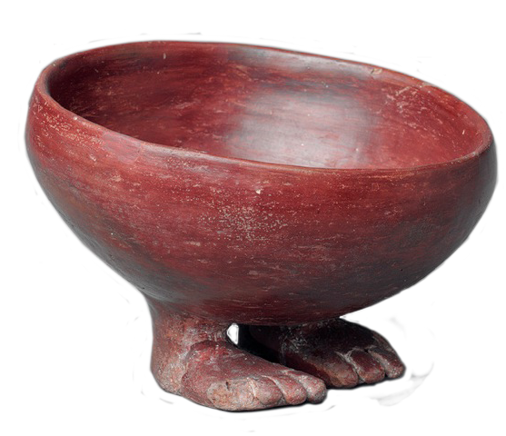
Pottery
Egyptian predynastic period footed funerary water bowl.
ca. 3750–3550 B.C.
Image: www.metmuseum.org
Heralding the dawn of the “Neolithic Revolution”, roughly 10,000 years ago thru to the early bronze age, pottery is part of our ubiquitous material culture using materials that are widely available as a “technology that was modified and developed to meet the needs of the people” (Fagan, 2004, pp. 38-39)
Design included functional shapes for storage and use, as well as artistic motifs, symbols and colouring presenting cultural relevance across an array of cultures.
Mesopotamian potter’s wheels of 3,000BC (Williams, 2000, p 40) were an important technological development, which happened to coincide with the first known wooden wheel. Potters wheels significantly altered pottery production, quality and styles.

Slide 3
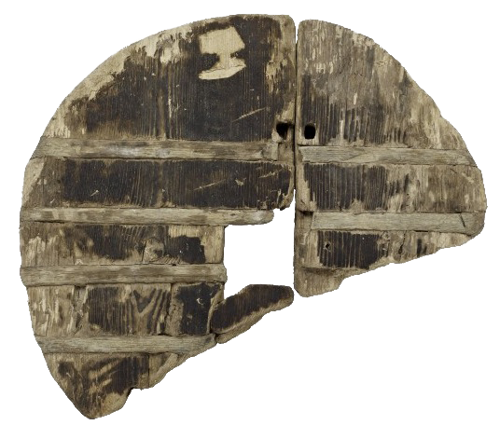
Wooden wheel of the Ljubljana Marsh
Re-discovered in Slovenia, Central Europe the oldest found wooden wheel dates to over 3,000BC.
This technology is likely to have been inspired by the ever present human need for efficient transport of goods and materials.
Use of various timber species (Ash & Oak) in construction indicate ancient development & application of differing material properties. (Dorling Kindersley, 2010, P 146.)
The Wooden wheel of the Ljubljana marshes, Slovenia.
Image: www.mgml.si

Slide 4
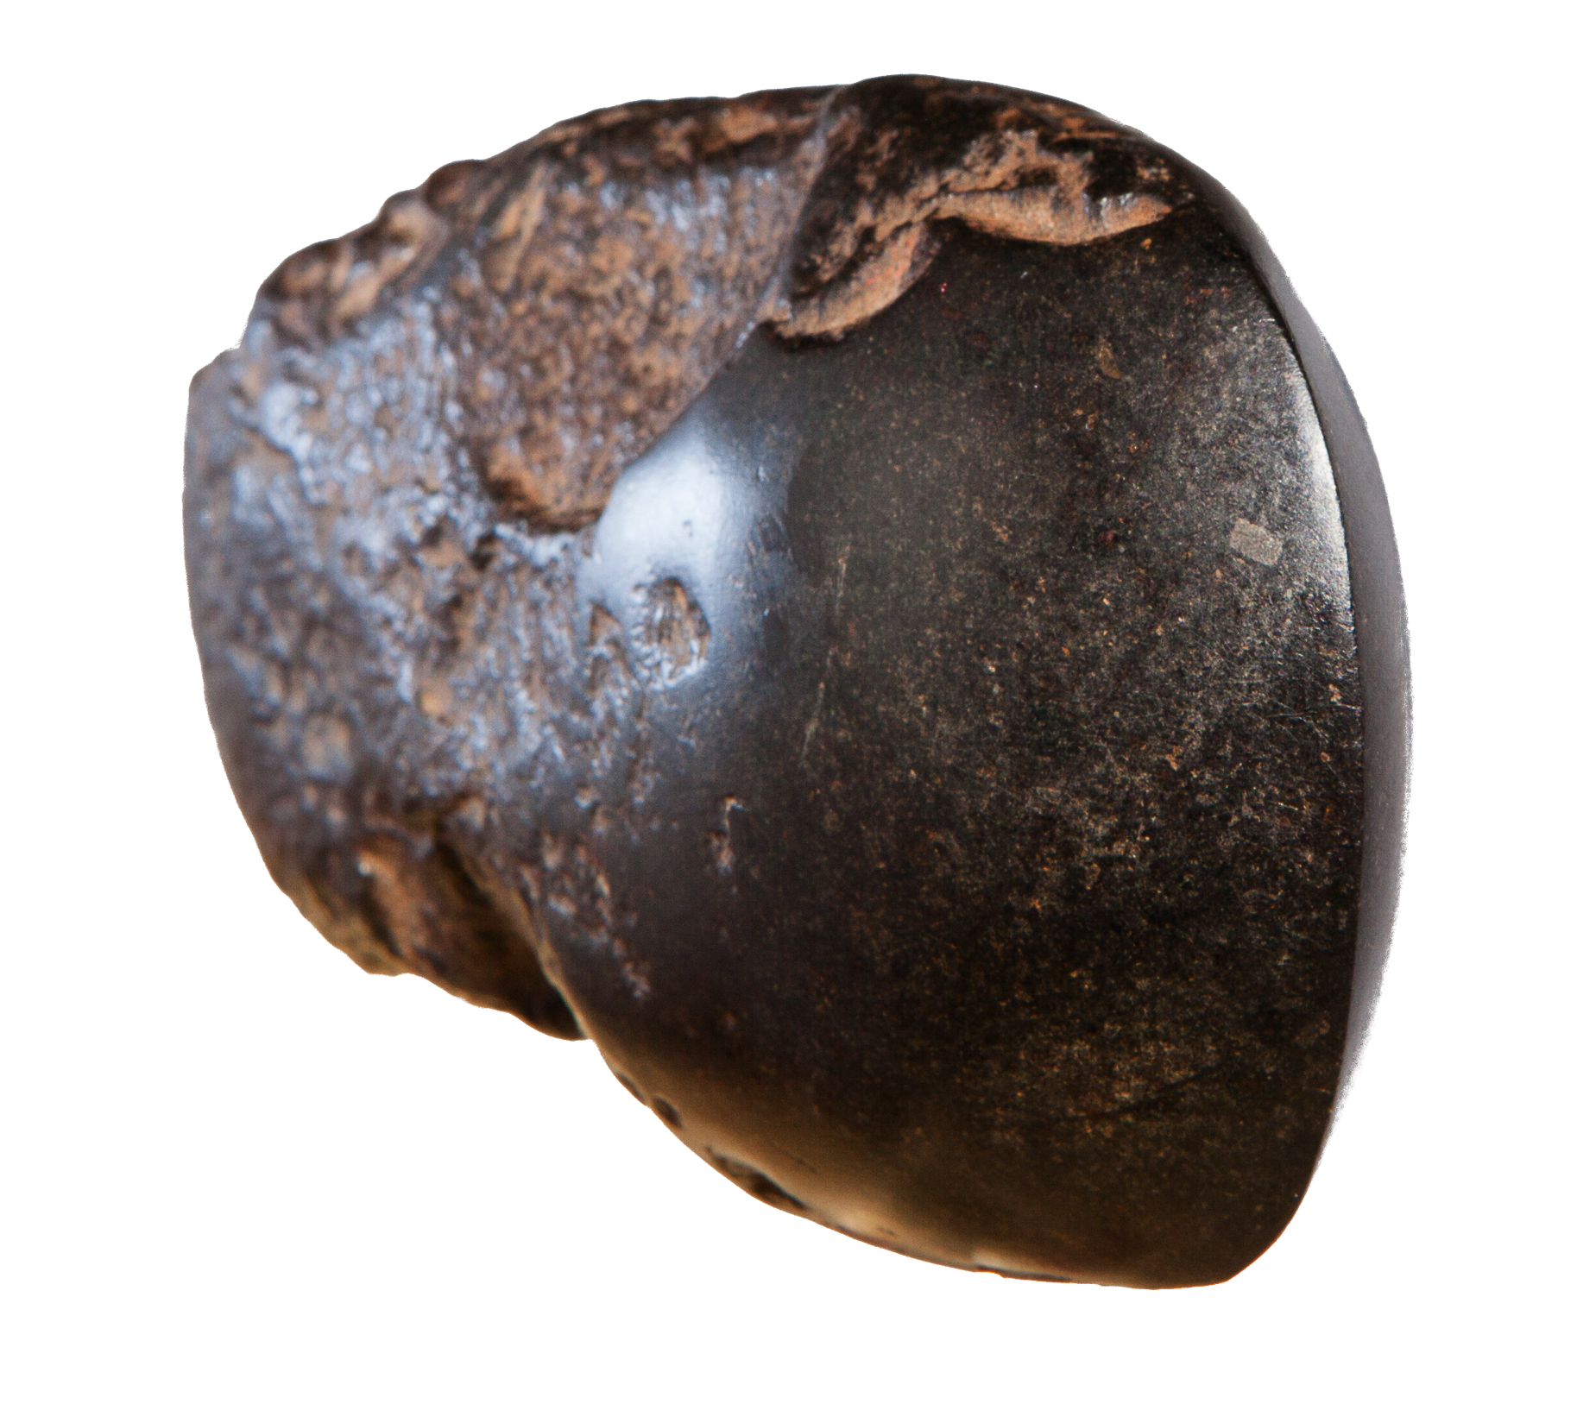
Aboriginal Stone Axe Head
40, 000BC to 1840AD
Ground stone axes heads were sourced from
many locations throughout Australia (NSW DPI 2007, P2).
Wurundjeri people of Mt William quaried the hard stone
to create ground edged hatchets for working timber, butchering animals & widespread trade (museumvictoria.com.au).
Brumm (2010, p. 182 & 193) quotes McBryde in suggesting
Mt William’s axe heads were valued for symbolic purposes
and not put to everyday use. Equivalent local outcrops meant
there was no technological necessity for such distant trading.
This greenstone axe head, in seemingly perfect condition, was found at Tottenham, central NSW during the 1920’s and may well have originated from Mt Wilson, Victoria some 600km to the South.
Image: Cam Mills 2013

Slide 5
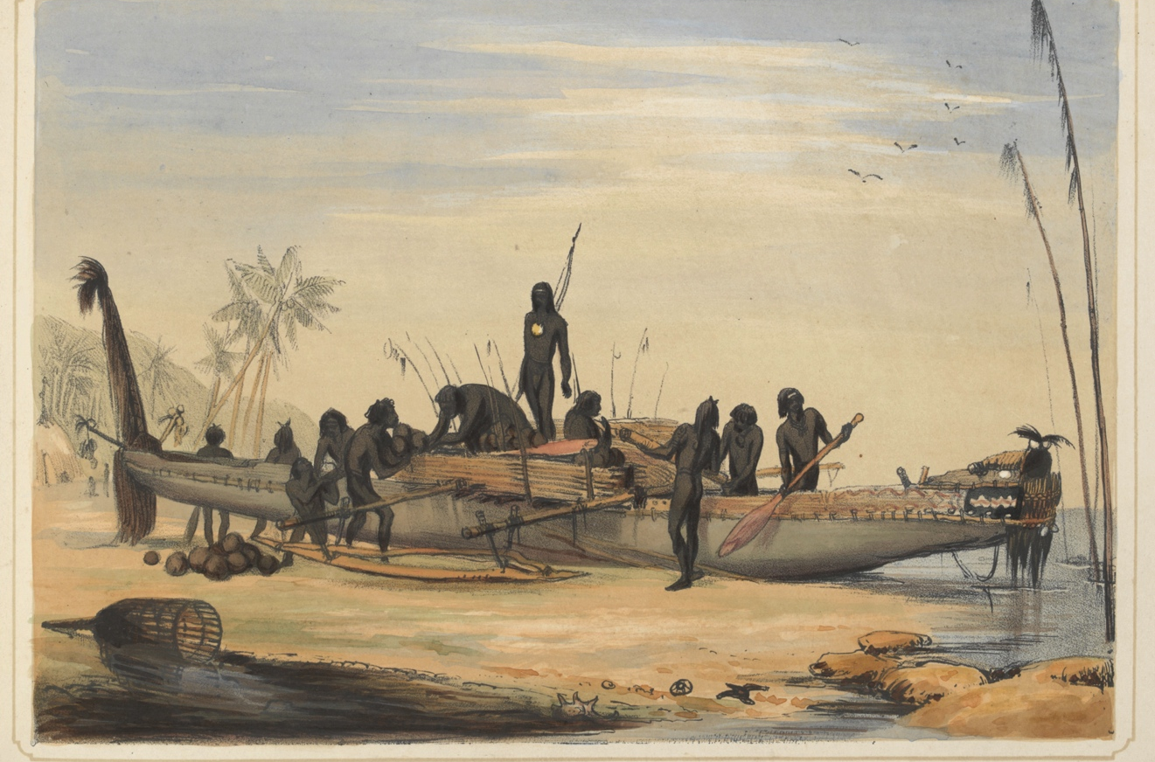
Canoe of Darnely Island, 1849. Harden S. Melville.
Plate no. XIX of: Sketches in Australia and the adjacent islands. Shows dugout canoe being prepared for a voyage.
Image: Sourced from State Library of Victoria
Torres Straight Seafaring Dugout Canoe
Seafaring canoes have plied Northern Australian waters for up to 8,000 years, with many seafaring technologies in evidence for at least 3,000 years (Florek, 2012).
Oakes (2013) states a variety of natural materials and techniques were combined into canoe components, such as canoe sails.
Canoes were employed in fishing, trading, travelling and exploration, with celestial navigation enabling longer ocean voyages. Double outriggers suited strong currents found in the Torres Straight (australia.gov.au).

Slide 6
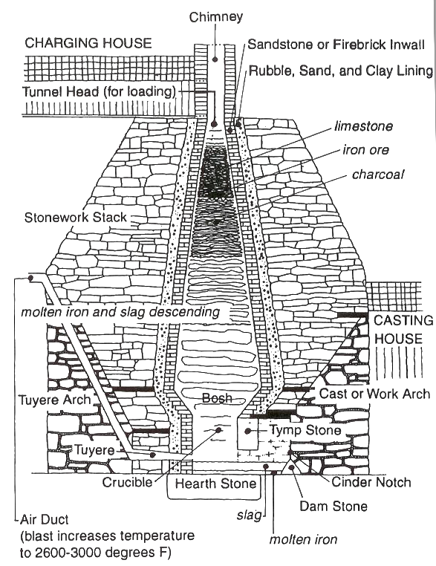
Charcoal Fueled
Blast Furnace
9th Century BC China saw the blast furnace used in iron production (Fagan, 2004, P48).
About 12th Century AD the first “true blast furnaces” appear in medieval Europe, at Lapphyttan, Sweden and later France in 1400 (engr.psu.edu, n.d.).
Significant demand for improved malleable iron drove development and investment in blast furnaces. Weapons, ploughs, horse shoes, industrial machinery, nails, tools were all sought after in an increasingly affluent and developing medieval Europe. One acre of hardwood yielded the required charcoal for a days operation of a blast furnace. Dubiously dubbed the most efficient iron production process, deforestation, developments in coal originated fuels and later reductions in transport costs led to the demise of the medieval charcoal fueled blast furnace. (engr.psu.edu, n.d.).
Cold Blast Charcoal Fueled Iron Furnace
Image: www.explorepahistory.com

Slide 7
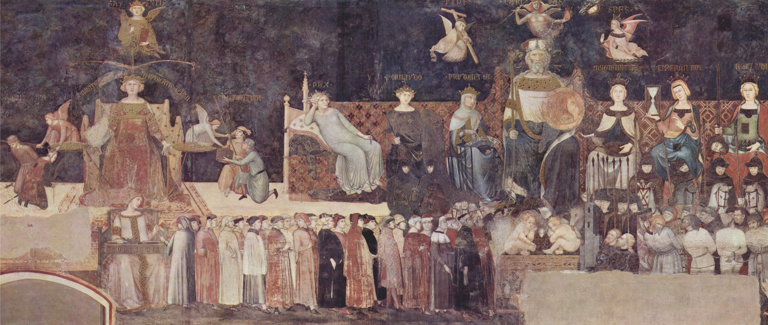
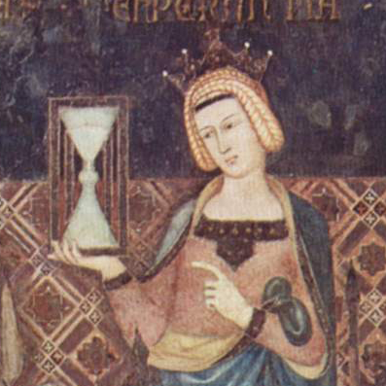
The Hour Glass
In its first known depiction (Evans, 2012, p27)
of 1339 the hourglass represents an allegory for
temperance in the Italian city state of Sienna.
As an affordable and accessible technology its development “appears
unquestionably linked to the development of shipboard technology
of the seagoing vessels [of the middle ages]” (Balmer, n.d. p.615).
Considering its simplicity, hourglass heritage maybe much older.
The similar clepsydra water clock was developed 1,400BC (britanica.com)
Ambrogio Lorenzetti’s Allegory of Good Governement, 1339.
Image: upload.wikimedia.org

Slide 8
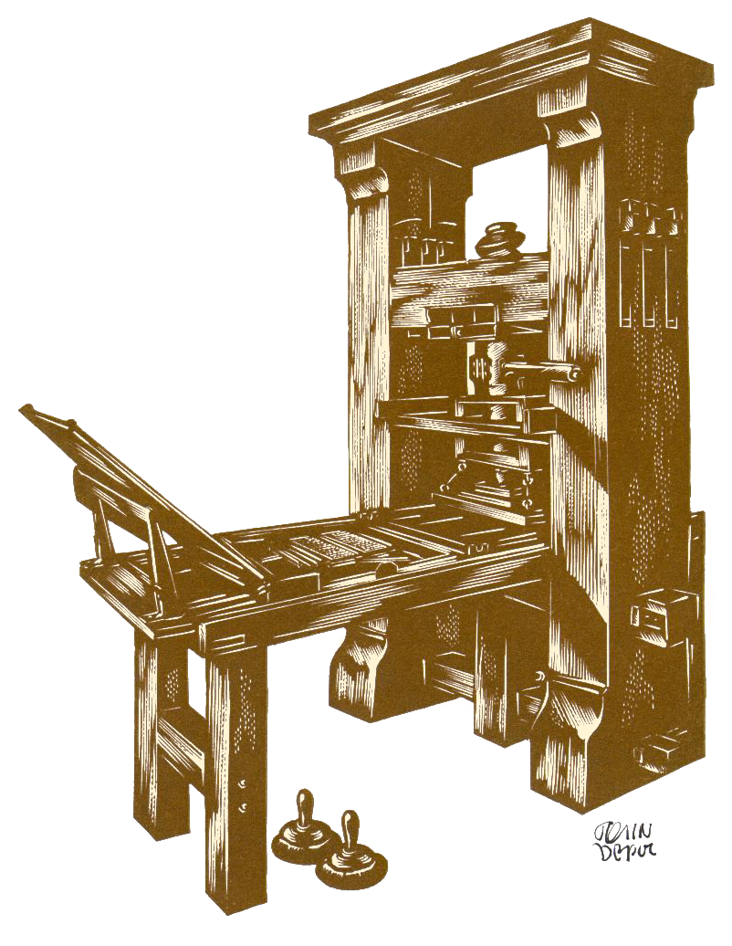
Gutenberg’s Press
Known as the “German Art”, Gutenberg’s printing press of the 1450’s “is by far the most significant” of changes at the dawn of the renaissance (Derry & Williams, 1993, p. 37).
During the 16th century cities with established printing presses grew 60% faster than those without, and Protestant Reformation “advocates of religious reform
exploited the new media to disseminate
their ideas” (www.jeremiahdittmar.com)
Using moveable type Gutenberg first
printed the bible which fostered individual interpretation and brought progress of science and education to the people (web.mit.edu).
It was undoubtedly the greatest delivery system for information technology, and knowledge power for 500 years, until the development of the 21st Century internet.
Hypothetical reconstruction of Johann Gutenberg's Printing Press, 1994
Image: www.libraries.rutgers.edu

Slide 9
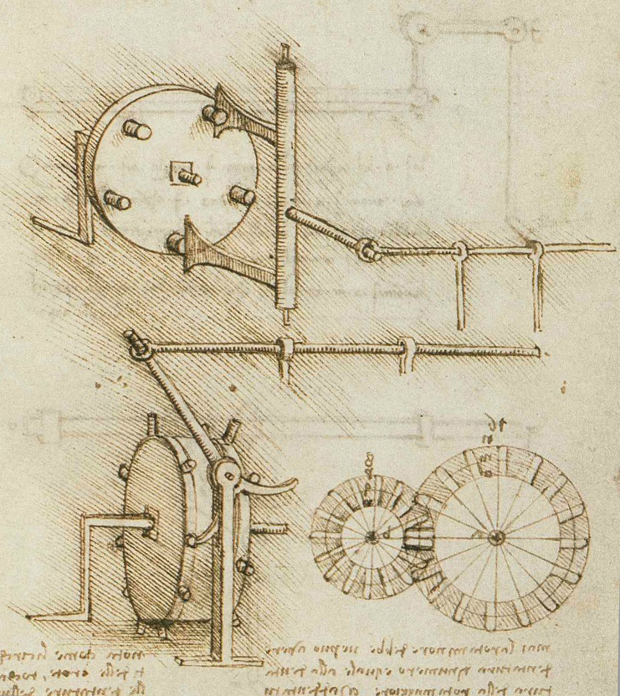
Perhaps da Vinci’s earliest sketches of the crank & connecting rod?
Image: www.leonardodigitale.com
The Crank &
Connecting Rod
Whilst evident in ancient Rome the system of crank & connecting rod became prominent during the renaissance, as “Italian geniuses of the Renaissance rose superior to the ancient snobbery which had despised the base mechanic arts”. (Derry & Williams 1993)
“With extraordinary rapidity these devices were absorbed into Europe’s technological thinking and used for the widest variety of operations” (White, 194, p. 115).
Mechanical conversion of reciprocating to rotary motion efficiently harnessed many energy sources including wind & water, enhancing competitive economic advantage.

Slide 10
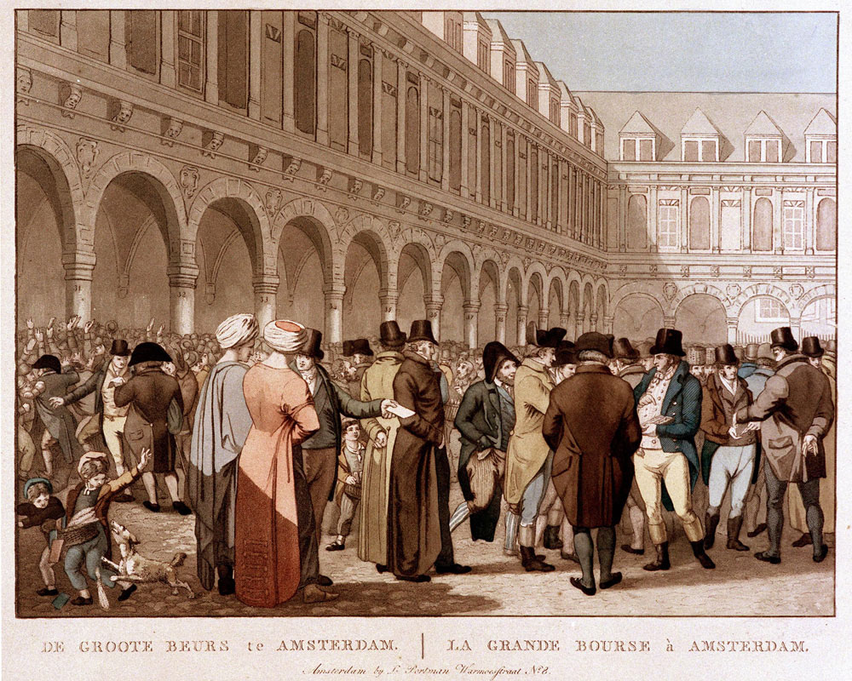
Amsterdam Stock Exchange
Image: www.moaf.org
The world’s first stock
exchange was opened in
1611, specially designed
for open air trade of listed shares in
The VOC (Dutch East India Company). Trading raised necessary
capital for growth required by the VOC. (www.beursvanberlage.nl)
This revolution in financial technology enabled development & defense of the Dutch empire whilst extending significant international financial, commercial and political influence. New York’s international standing as share trading capital of the world was influenced by the Dutch arrival & settlement in 1625. (www.moaf.org)

Slide 11
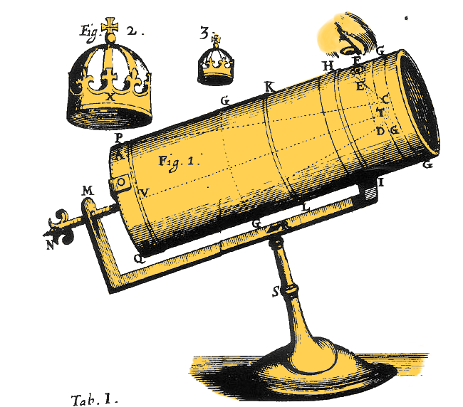
Newtonian
Reflecting
Telescope
Designed to study light refraction Newton’s reflecting telescope of 1668 eliminated optic lenses as previously used, which caused chromatic aberration (colour distortion).
Internal reflective mirrors
made it possible to “magnify objects millions of times” (Philbin, 2003, p. 170).
The device allowed Newton to prove “gravitation was a two way operation” which “was clearly seen, calculated, and confirmed in the motions of heavenly bodies…” (Kalif, 2008)
Isaac Newton’s Reflecting Telescope
Image: www.museumvictoria.com.au

Slide 12
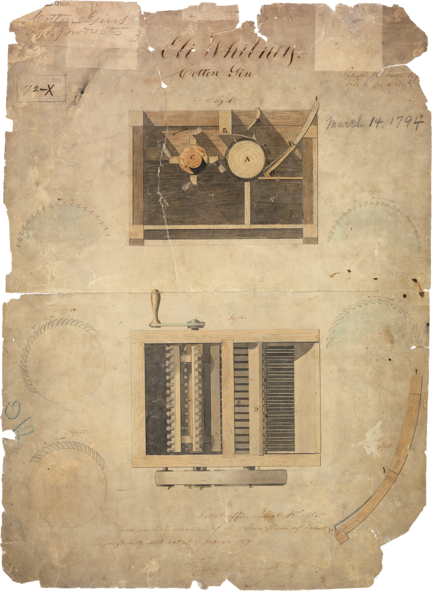
The Cotton Gin
In 1793 the Cotton Gin was designed in America and was to become a simple technology that played a significant role in reshaping global trade, economic production and international slavery. (Williams, 2000, p. 148).
By speeding the process and quality of separation of cotton from the pod American technology provided a commercial advantage to local growers over traditional suppliers to England, being the East and West Indies and Egypt and India.
In the 35 years from 1795 US exports of cotton increased by a factor of about 45 times (Williams, p. 148-149).
Patent for Cotton Gin, 1794.
Image: www.upload.wikimedia.org

Slide 13
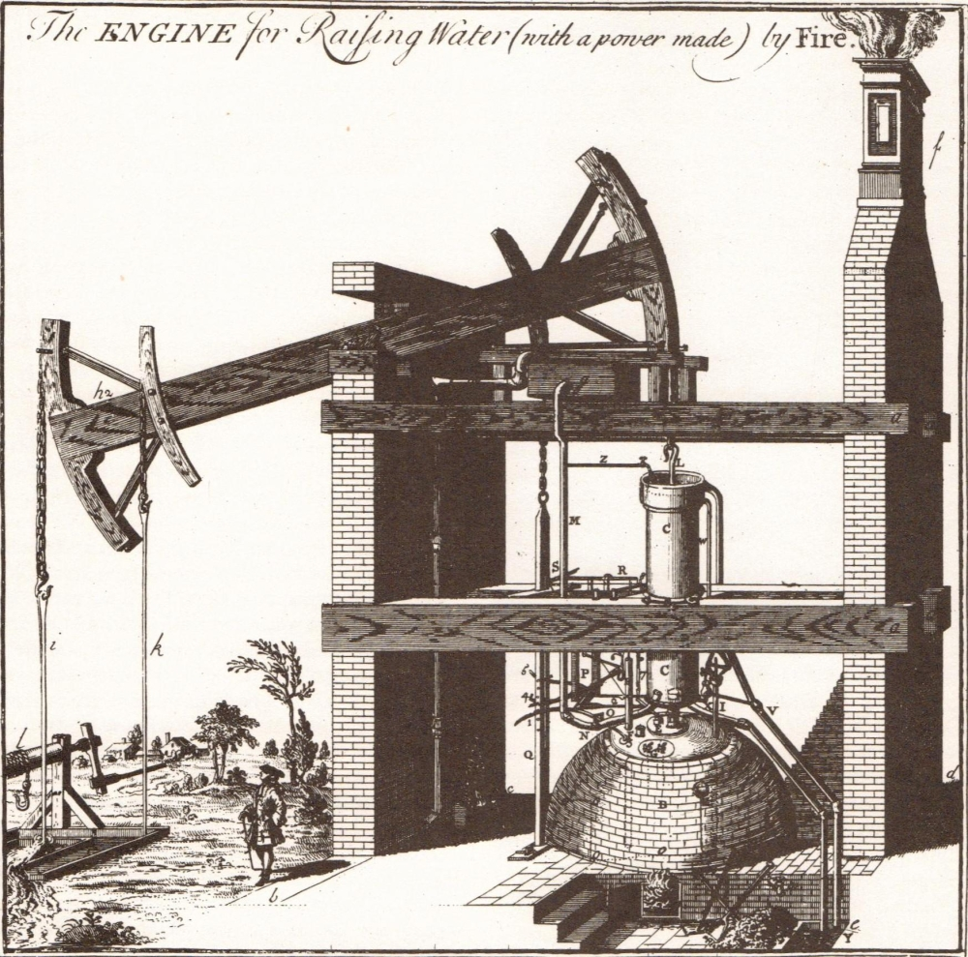
The Steam Engine
First patented in 1698, designed in metals and timber and housed in new large factories steam power was “undoubtedly the greatest technical achievement of the Industrial Revolution” and “its application was virtually limitless” (www.yale.edu).
Ongoing steam engine development improved production efficiency, powered land and sea transport, created massive demand for (and pumping of) coal mining and iron working whilst fostering significant scientific and engineering development (Williams, 2000, p 160-164).
Dickens (1905, p.56) describes the time “A clattering of clogs upon the pavement; a rapid ringing of bells; and all the melancholy mad elephants, polished and oiled up for the day’s monotony…”.
Diagram of First Newcomen Engine by Henry Beighton 1717
Image: www.bshs.org.uk

Slide 14
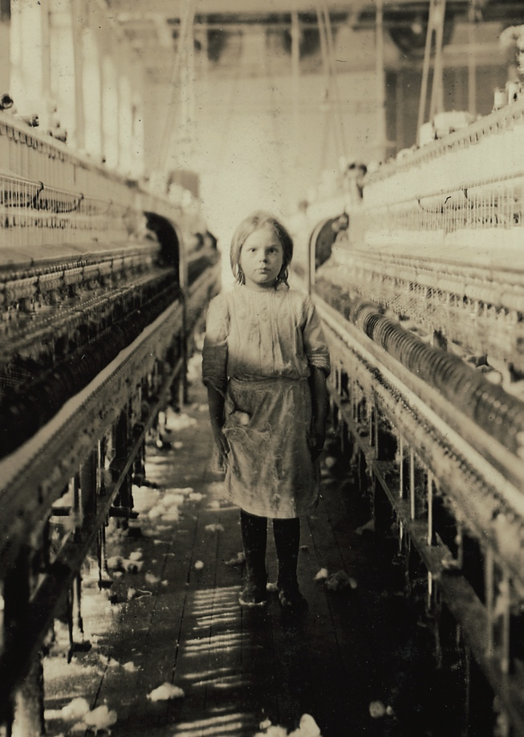
The Factory
A common workplace of the industrial revolution, found in all industrialised nations. A 1770’s water driven mill at Cromford, U.K. may have been the first factory, as machines within the building required organisation and power, eliminating the opportunity to work from homes as was done earlier. (Williams, 2000, p. 147)
As sources of “persistent industrial
pollution” (Stearns 2007, P273) factories were “blamed for introducing long hours, the exploitation of children and bad working conditions. All these, however, had been the lot of domestic workers for generations” (Aspin, 1987, p.30)
Labour movement, especially low skilled immigration & displaced rural inhabitants fed factories across the globe. (Stearns, p.284)
A little spinner in the Mollahan Mills, Newberry, S.C. Image: www.loc.gov

Slide 15

Polymers
“Almost entirely a product of the 20th century”
the huge modern polymer industry dates from
1909 with the invention of Bakelite. By mid
century 200,000 tons was produced annually
(Williams, 2000, p266).
Bakelite, “the material of a thousand uses”(www.gpraweb.com)
could replicate the style of earlier objects, replacing demand for
natural materials such as ivory, horn, wood, bone, nacre and shell.
The burgeoning international automotive and electrical industries benefitted from mass produced insulating polymers. The 1920’s & 30’s saw development of pigmented polymers that were used extensively for domestic appliances and articles (Williams p.267).
Early Bakelite (Phenol Resin)
Sawyer’s Viewmaster Stereoscope
Image: www.flickr.com

Slide 16
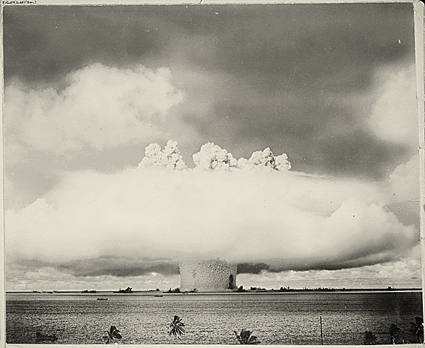
Nuclear Fission
Theorised in peace time it was WWII that drove frantic development of nuclear fission, for the purpose of
building an atomic bomb (Philbin, 2003, p53).
In a race to out-gun its foes “the atomic bomb was a turning point for humanity”, and as a technology entirely capable of Earth’s decimation
it has greatly influenced government policy since its development (Philbin, p.54).
Following the bomb nuclear technologies transformed power generation, medicine, space exploration, mining and industry (ww.nei.org).
Atomic cloud during Baker Day blast at Bikini, 07/25/1946
Image: research.archives.gov

Slide 17
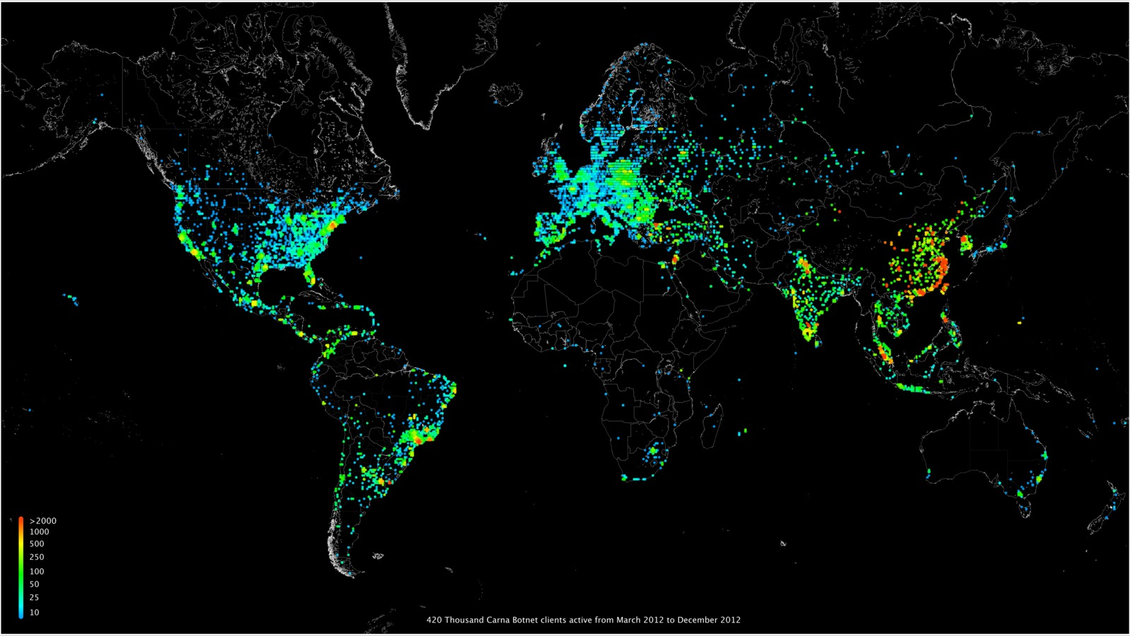
World Wide Web
The internet is a late 20th century phenomenon recognised by the 2013 Queen Elizabeth Prize for Engineering as an advance in engineering that has changed the world (qeprize.org)
Lamenting early computing inability to “store random associations between disparate things” where humans could, Tim Berners-Lee (www.w3.org) dreamt of creating “a common information space in which we communicate by sharing information.”
The internet is a melting pot from where new social, economic and political experiences are constantly being served. Media, commerce, health, communications, technology, education, politics, science, warfare, navigation, culture, leisure and humanity have all been influenced.
~460 Million IP addresses on world map
Image: internetcensus2012.bitbucket.org/paper.html

Slide 18
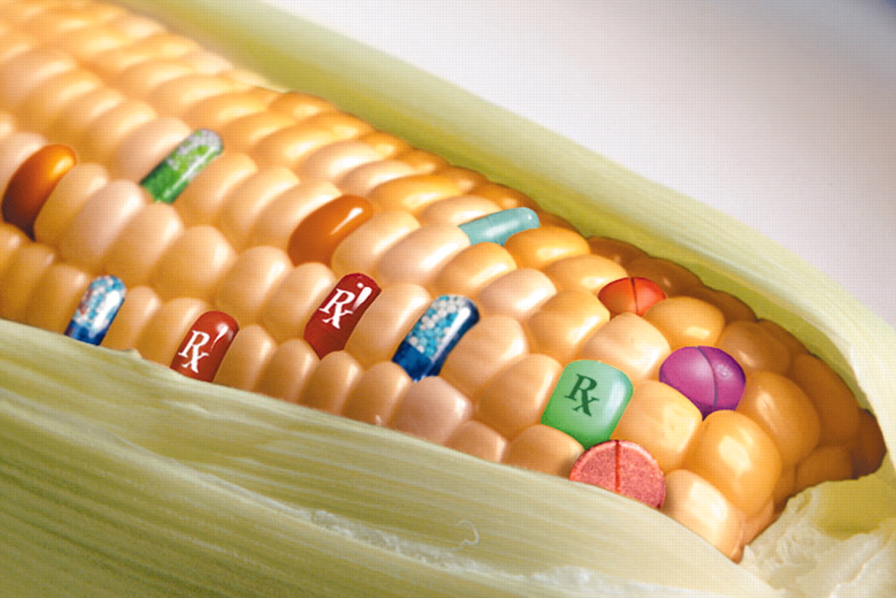
Genetic Engineering in Agriculture
Throughout history humans have
selected for genetic traits, including
orange carrots, Dutch tulips and
Merino sheep & thoroughbred horses.
Whilst science developed truly engineered processes from the 1950’s it was in 1990 that the US FDA endorsed the first food product to be created by genetic engineering (Williams, 2000, p297). The economic promises of “yield increases, reduced fertilizer use, and drought tolerance” are claimed to be marginal, whilst problems GE caused include large monoculture farming, herbicide resistant “super weeds” and reductions in the number of bird and bee populations (http://www.ucsusa.org). Greenpeace (2010) says “corporate control of agriculture “ is being achieved through the courts as business relies on patents to protect their interests, causing a flow on effects as “seed prices are skyrocketing”.
When corn will be used to produce chemicals and pharmaceuticals…Image: www.plantphysiol.org

Slide 19
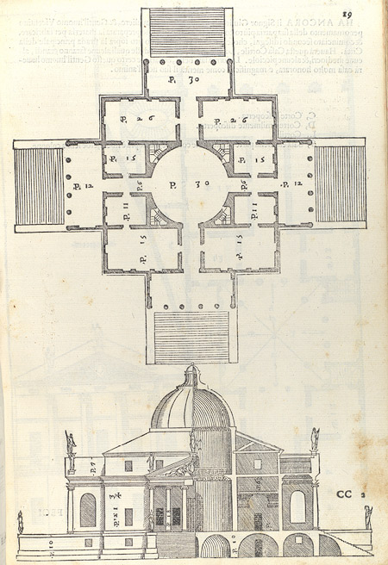

Italian Renaissance Architecture
Italian Renaissance architecture flourished from the 15th to 17th centuries, influenced by Florentine architects and their use of form, symmetry, proportion & scale (www.metmuseum.org).
With origins in classical Greek, Roman & Eastern architecture including the Hagia Sofia in Constantinople from the 6th Century, where “all spaces had been generated outward from a domed core” (www.saintpetersbasilica.org).
The New World with its precious metals and jewels brought fabulous wealth to principalities and the papacy. With renewed stability the “greatest artists of the age” were attracted to Rome’s “colossal token of victory”, St Peter’s Basilica (www.saintpetersbasilica.org)
Villa Almerico (Villa Rotonda), Venice 1570
Image: www.metmuseum.org

Slide 20
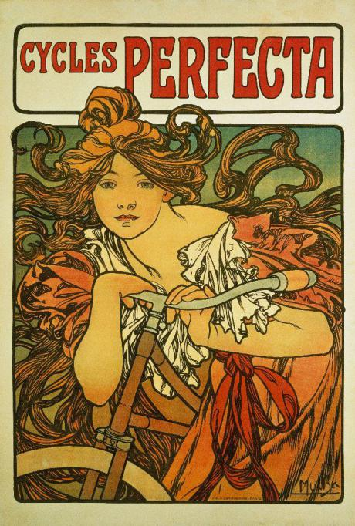
Art Nouveau
Described as the first truly modern international design, Art Nouveau emerged in the late 1880s rejecting past styles, instead featuring “organic foliate forms, sinuous lines and curvilinear whiplash motifs”. The style was inspired by the British Arts and Crafts movement but was not limited to art, as also evidenced in furniture production, architecture and interior design (Bhaskaran, 2005, p 42).
The Cycles Perfecta advertising poster, being a mass produced graphic design was typical of Art Nouveau style. The artist, Alphonse Mucha “believed passionately that art was an essential benefit to humanity and that it should be seen and enjoyed by as many people as possible.” (www.muchafoundation.org)
Poster advertising 'Cycles Perfecta', 1902
Image: missrosen.wordpress.com

Slide 21

Art Deco
Art Deco was an enormously popular and globally influential design style thru the 1920’s & 30’s.
Featuring streamlined symbols of grand and exotic modernity the glamorous style featured in fashion, sculpture, automotive design, architecture, textiles, glassware, furniture, home wares, and art (www.dgdesignnetwork.com.au).
Art Deco had many influences, from brightly coloured costumes of the Russian ballet to Tutankhamen's artifacts to avant-garde paintings. (Bhaskaran, p 86)
AWA, Sydney - 'Empire State, Fisk radiolette and cigarette box' 1936.
Image: www.dgdesignnetwork.com.au

Slide 22
References
1611: First Stock-Exchange in the world. (n.d.). Retrieved from http://www.beursvanberlage.nl/1611/
600 Million Years - Stone tools: Melbourne Museum. (n.d.). Retrieved December 6, 2013, from http:// museumvictoria.com.au/melbournemuseum/discoverycentre/600-million-years/timeline/ quaternary/stone-tools/
Ackerman, J. S. (1966). The Architecture of Michelangelo. Retrieved from http://saintpetersbasilica.org/ Docs/AOM/ ArchitectureofMichelangelo-1.htm
Anonomous (n.d.). ~460 Million IP addresses on worldmap [Screen Capture]. Retrieved from http://internetcensus2012.bitbucket.org/images/worldmap_lowres_16to9_1600x900.png
Architecture in Renaissance Italy | Thematic Essay | Heilbrunn Timeline of Art History | The Metropolitan Museum of Art. (n.d.). Retrieved from http://www.metmuseum.org/toah/hd/ itar/hd_itar.htm
Art Deco: 1910-1939 – NGV, Melbourne |. (n.d.). Retrieved from http://www.dgdesignnetwork.com.au/ dgdn/dg-magazine-131/art-deco-1910-1939-ngv-melbourne/
Australia's maritime history under sail | australia.gov.au. (2009, December 17). Retrieved from http:// australia.gov.au/about-australia/australian-story/australias-maritime-history-under-sail
AWA, Sydney - 'Empire State, Fisk radiolette and cigarette box' 1936 [Photograph]. (n.d.). Retrieved from http://www.dgdesignnetwork.com.au/dgdn/dg-magazine-131/art- deco-1910-1939-ngv-melbourne/
Bakelite Corporation (n.d.). Bakelite - The material of a thousand uses [Press Clipping]. Retrieved from http://www.gpraweb.com/fileadmin/user_upload/press/press_bakelite.jpg
Balmer, R. T. (n.d.). The operation of sand clocks and their medieval Development. Retrieved from http://tinyurl.com/n3z9phl
Beighton, H. (1717). Diagram of First Newcomen Engine by Henry Beighton 1717 [Line Art]. Retrieved from http://www.bshs.org.uk/travel-guide/tag/steam

Slide 23
Berners-Lee, T. (1998, May 7). The World Wide Web: A very short personal history. Retrieved from http://www.w3.org/People/Berners-Lee/ShortHistory.html
Bhaskaran, L. (2005). Designs of the times: Using key movements and styles for contemporary design. Mies: RotoVision.
The big ideas that changed the world. (2010). London: Dorling Kindersley.
Brumm, A. (2010). ‘The Falling Sky’: Symbolic and Cosmological Associations of the Mt William Greenstone Axe Quarry,Central Victoria, Australia. Retrieved from http://tinyurl.com/ nh4xcws
clepsydra (timekeeping device) -- Encyclopedia Britannica. (n.d.). Retrieved from http:// www.britannica.com/EBchecked/topic/121262/clepsydra
Cold Blast Charcoal Fueled Iron Furnace [Line Drawing]. (n.d.). Retrieved from http:// explorepahistory.com/displayimage.php?imgId=1-2-DFC
Da Vinci, L. (n.d.). Codex Madrid I - Plate 0007r [Sketch]. Retrieved from http:// www.leonardodigitale.com/index.php?lang=ENG
Department of the Navy (USA) (n.d.). Atomic cloud during Baker Day blast at Bikini, 07/25/1946 [Photograph]. Retrieved from http://research.archives.gov/description/520714
Derry, T. K., & Williams, T. I. (1993). A short history of technology. Canada: General Publishing Co. Ltd.
Dickens, C. (1905). Hard Times and Reprinted Pieces. London: Chapman & Hall.
Dittmar, J. (n.d.). Research. Retrieved from http://www.jeremiahdittmar.com/research
Early Reflectors (Cosmology: Tools). (2013). Retrieved from http://www.aip.org/history/ cosmology/tools/tools-early-reflectors.htm

Slide 24
Eggert, G. (n.d.). Medieval Technology and American History - In-Depth Articles - The Rise and Fall of Medieval Iron Technology. Retrieved from http://www.engr.psu.edu/MTAH/articles/ rise_fall_medieval_technology.htm
Evans, K. (2012). Colonial virtue: The mobility of temperance in Renaissance England. Retrieved from http://tinyurl.com/n3gl24f
Exhibits - Actien Handel - Museum of American Finance. (n.d.). Retrieved from http://www.moaf.org/ exhibits/actienhandel/index
Fagan, B. M. (2004). The seventy great inventions of the ancient world. London: Thames & Hudson.
Florek, S. (2012, June 26). Tentative Chronology of Indigenous Canoes of Eastern Australia - Australian Museum. Retrieved from http://australianmuseum.net.au/BlogPost/Science/Tentative- Chronology-of-Indigenous-Canoes-of-Eastern-Australia
Footed Bowl, Predynastic Period, probably late Naqada I–early Naqada II, ca. 3750–3550 B.C [ Photograph]. (n.d.). Retrieved from http://www.metmuseum.org/toah/works-of-art/ 10.176.113
Genetic Engineering Benefits: Promise vs. Performance | Union of Concerned Scientists. (2013, June 26). Retrieved from http://www.ucsusa.org/food_and_agriculture/our-failing-food-system/ genetic-engineering/genetic-engineering-benefits.html
Genetic engineering enforces corporate control of agriculture | Greenpeace International. (2010, July 19). Retrieved from http://www.greenpeace.org/international/en/publications/reports/GE- enforces-corporate-control-of-agriculture/
Hine, L. (1905). A little spinner in the Mollahan Mills, Newberry, S.C [Photograph]. Retrieved from http://www.loc.gov/pictures/resource/nclc.01451/
Hypothetical reconstruction of Johann Gutenberg's Printing Press, 1994 [Drawing]. (n.d.). Retrieved from http://www.libraries.rutgers.edu/rul/libs/scua/depol_images/jdp9.shtml

Slide 25
The Industrial Revolution. (n.d.). Retrieved from http://www.yale.edu/ynhti/curriculum/units/ 1981/2/81.02.06.x.html
Inventor of the Week: Archive Gutenberg. (n.d.). Retrieved from http://web.mit.edu/invent/iow/ gutenberg.html
Isaac Newton's Reflecting Telescope [Line Art Sketch]. (n.d.). Retrieved from http:// museumvictoria.com.au/scidiscovery/image_pages/mn010113.asp
Kalif, W. (2008, 16). How Newton’s Telescope Changed the World | SciSeek Science Blog. Retrieved from http://blog.sciseek.com/2008/09/16/how-newtons-telescope-changed-the-world/
La Grande Bourse à Amsterdam [Postcard Print]. (n.d.). Retrieved from http://www.moaf.org/exhibits/ actienhandel/handelaren-hendrick-keyser-capital/_res/id=Picture/Handelaren-Hendrick-de- Keyser-Capital-950742-0-47.jpg?modal=1
Lees-Milne, J. (n.d.). St Peter's - Final Page. Retrieved from http://saintpetersbasilica.org/Docs/JLM/ SaintPeters-12.htm#final
Lees-Milne, J. (n.d.). St Peter's - Page 5. Retrieved from http://saintpetersbasilica.org/Docs/JLM/ SaintPeters-5.htm
Lorenzetti, A. (1339). Allegory of Good Government [Fresco]. Retrieved from http:// upload.wikimedia.org/wikipedia/commons/e/e8/Ambrogio_Lorenzetti_002.jpg
Melville, H. S. (1849). Canoe of Darnely Island [Photograph]. Retrieved from http:// handle.slv.vic.gov.au/10381/132271
Mucha, A. (1902). Poster advertising 'Cycles Perfecta', 1902 [Poster]. Retrieved from http:// missrosen.wordpress.com/2011/10/19/mucha/
NSW DPI (2007). Mining by Aborigines - Australia's First Miners (Primefact 572). Retrieved from http://www.dpi.nsw.gov.au/__data/assets/pdf_file/0008/109817/mining-by-aborigines.pdf

Slide 26
Nuclear Energy Institute - Industrial Uses. (n.d.). Retrieved from http://www.nei.org/Knowledge-Center/ Other-Nuclear-Energy-Applications/Industrial-Uses
Oakes, D. (2013). SCU Blackboard DES10636 Topic 2. Retrieved from https://learn.scu.edu.au/webapps/ blackboard/content/listContent.jsp?course_id=_129688_1&content_id=_3262828_1
Patent for Cotton Gin, 1794 [Document Reproduction]. (n.d.). Retrieved from http:// upload.wikimedia.org/wikipedia/commons/c/c5/Patent_for_Cotton_Gin_%281794%29_- _hi_res.jpg
Stearns, P. N. (2007). The industrial revolution in world history. Boulder, Colo: Westview Press.
Union of Concerned Scientists (n.d.). When corn will be used to produce chemicals and pharmaceuticals. [Photograph]. Retrieved from http://www.plantphysiol.org/content/132/4/1770/F1.large.jpg
Villa Almerico (Villa Rotonda), Venice 1570 [Woodcut Illustration]. (n.d.). Retrieved from http:// www.metmuseum.org/toah/works-of-art/41.100.126.19
The Wheel – 5,200 Years [Photograph]. (n.d.). Retrieved from http://www.mgml.si/en/city-museum-of- ljubljana-377/city-museum-of-ljubljana/future-exhibitions-523/wheel-5-200-years/
White, L. T. (1964). Medieval technology and social change. Retrieved from http://tinyurl.com/p3b48je
Williams, T. I., Schaaf, W. E., & Burnette, A. E. (2000). A history of invention: From stone axes to silicon chips. New York: Checkmark Books.
Winners | QEPrize. (n.d.). Retrieved from http://qeprize.org/winners/

